Slide 1
BATCH NO – C2
ONLINE CHEQUE CURATION AND ABSTRACT USING DEEP LEARNING ALGORITHMS
Team Members
B.MOUNIKA 208T1A05D5
T.PRAVEEN KUMAR 208T1A05H8
SK.ASHI 208T1A05H2
P.PRAVEEN KUMAR 208T1A05G8
D.PAVAN BABU 208T1A05D9
Guide​
Dr . ARUNA SAFALI PROFESSOR

Slide 2
ABSTRACT
This new online cheque curation and abstract system has become essential feature in modern banking system, allowing users to conveniently validate paper cheque remotely through digital platforms, eliminating the need for physical visits to bank. Traditional methods of cheque processing involve manual handling, which can be time - consuming and error-prone. The proposed system leverages deep learning models such as Residual Network (ResNet) and Optical Character Recognition (OCR), and to achieve accurate and efficient recognition of handwritten and printed text on cheques. By training on a diverse dataset of cheque images, the models are capable of identifying critical information like the payer’s name, amount, and date. Users can capture cheque images using their smart phones or other devices, and the deep learning models process the images to extract relevant information. The system performs authenticity verification through watermark analysis, micro printing detection, and signature verification. Once the cheque is validated, the extracted information will be displayed to user’s screen. The online cheque curation and abstract system is to revolutionize the efficiency and accuracy of cheques recognition and processing. And customer can speedily validate cheques easily, don’t have visit a physical bank, and cost savings.

Slide 3
INTRODUCTION
Online cheque curation and abstract system instantly process and verify cheques, extracting essential information.
Residual Neural Network (ResNet) uses the Skip Connection to train the system, Optical Character Recognition (OCR) used for the recognition of handwritten and printed text on cheques.
The data cleaning techniques are used for preprocessing the data and obtain a clean data. By training on a diverse dataset of cheque images, the models are capable of identifying critical information like payer’s name, amount, and date, signature.

Slide 4
EXISTING PROJECT
The existing project is a blockchain based scheme to authenticate cheques and detect fake cheque scams. Moreover, the approach allows the revocation of used cheques.
The Blockchain-Based Solution for Detecting and Preventing Fake Check Scams Project uses the Name Coin and Hyperledger blockchain technologies.
The existing system is up to detecting weather the cheque is fake or not, but it does not provide the signature verification and OTP authentication.

Slide 5
LITERATURE SURVEY
Blockchain-Based Solution for Detecting and Preventing Fake Check Scams: Authors: Badis Hammi, Yves Christian Elloh Adja, Manlio, and Jamel Nebhen. Published year 2022. The project is a blockchain based scheme to authenticate cheques and detect fake cheque scams. Moreover, the approach allows the revocation of used cheques.
Online Digital Cheque Clearance and Verification System using Block Chain: Bogahawatte W.W.M.K.A, Isuri Samanmali A.H.L, Perera K.D.M, Senaratne A.N, Rupasinghe L.P. Published year 2021. The proposed system provides benefits to the user as well as the bank by addressing the requirement of producing a secure, effective and environment friendly system. Finally, Checkmate permits a consistent stream of cheque clearance operation for the payer and the payee without any mediators.

Slide 6
PROPOSED SYSTEM
This new online cheque curation and abstract system has become essential feature in modern banking system, allowing users to conveniently verify the paper cheque remotely through digital platforms, eliminating the need for physical visits to bank.
Users can capture cheque images using their smart phones or other devices, and the deep learning models process the images to extract relevant information.
The system performs authenticity verification through watermark analysis, micro printing detection, and signature matching.
Once the cheque is validated, the extracted information from the cheque will be displayed to the user’s screen.

Slide 7
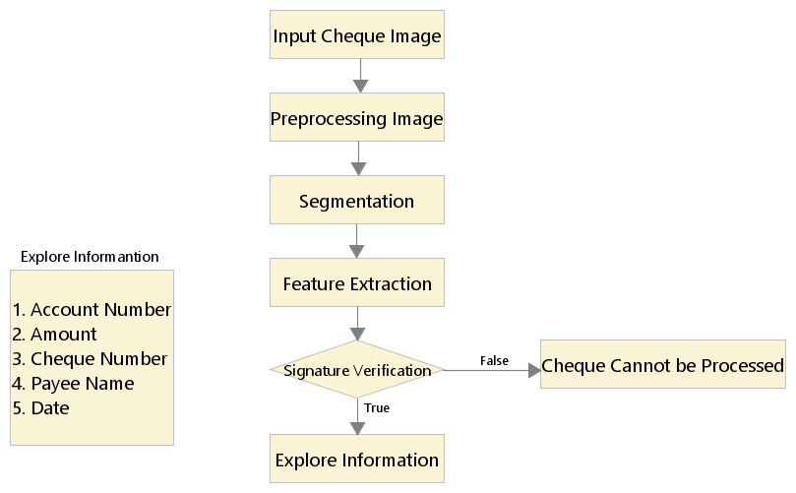
FLOW CHART

Slide 8
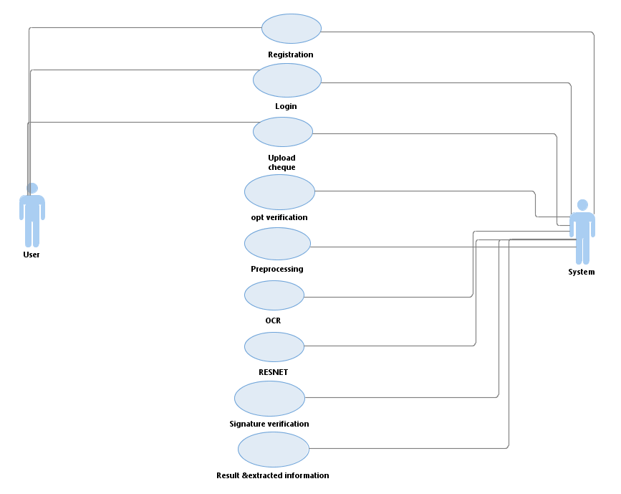
Use Case Diagram: A use case diagram is used to represent the dynamic behavior of a system. It encapsulates the system's functionality by incorporating use cases, actors, and their relationships. The actors in the use case diagram are user, and the person who initiates the process of Online cheque curation and abstract system, component responsible for processing cheque.

Slide 9
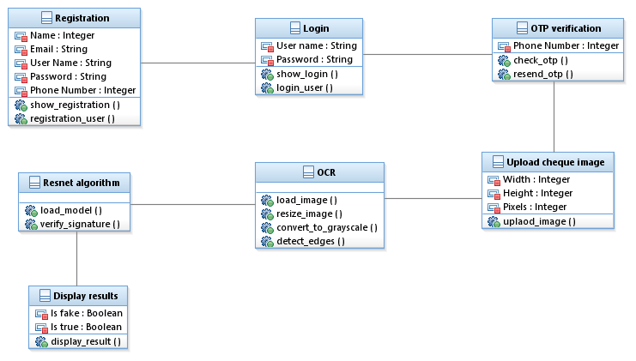
Class Diagram:
It depicts a visual representation of the static, structural aspects of a system by showcasing classes, their attributes, methods, and their interrelationships. Classes are depicted as boxes with attributes and methods listed within.

Slide 10
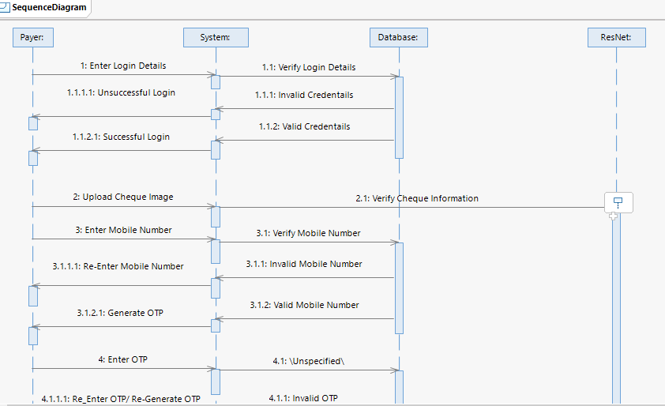
Sequence Diagram: It shows the interactions between the objects in terms of messages exchanged over time. It delineates in what order and how the object functions are in a system.

Slide 11
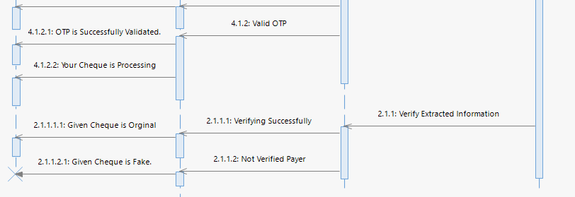

Slide 12
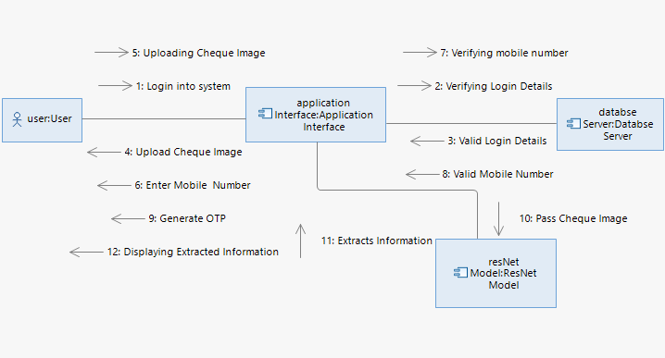
Communication Diagram: A Communication diagram models the interactions between objects or parts in terms of sequenced messages. Communication diagrams represent a combination of information taken from Class, Sequence, and Use case Diagram describing both the static structure and dynamic behavior of a system.

Slide 13
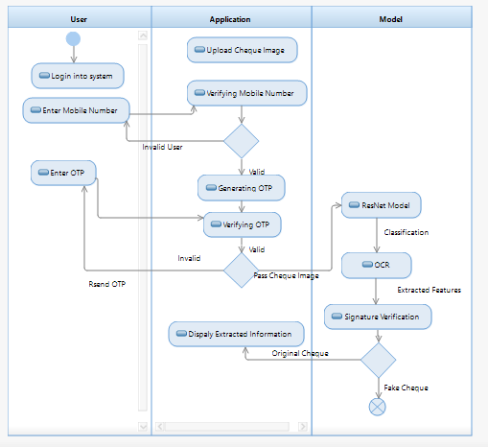
Activity Diagram:
It models the flow of control from one activity to the other. With the help of an activity diagram, we can model sequential and concurrent activities. It visually depicts the workflow as well as what causes an event to occur.

Slide 14
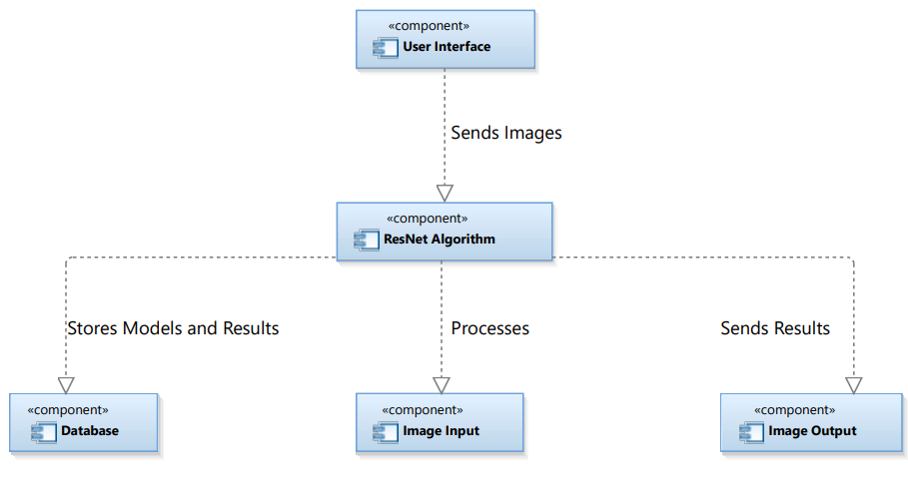
Component Diagram:
A component diagram is used to visualize and document the structural aspects of a system. It focuses on the high-level organization of the system's components and their interactions.

Slide 15
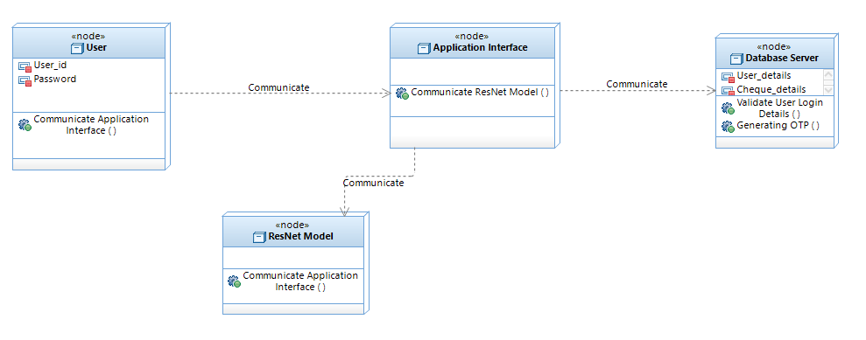
Deployment Diagram: Deployment diagram is a diagram that shows the configuration of run time processing nodes and the components that live on them. Deployment diagrams is a kind of structure diagram used in modeling the physical aspects of an object-oriented system.

Slide 16
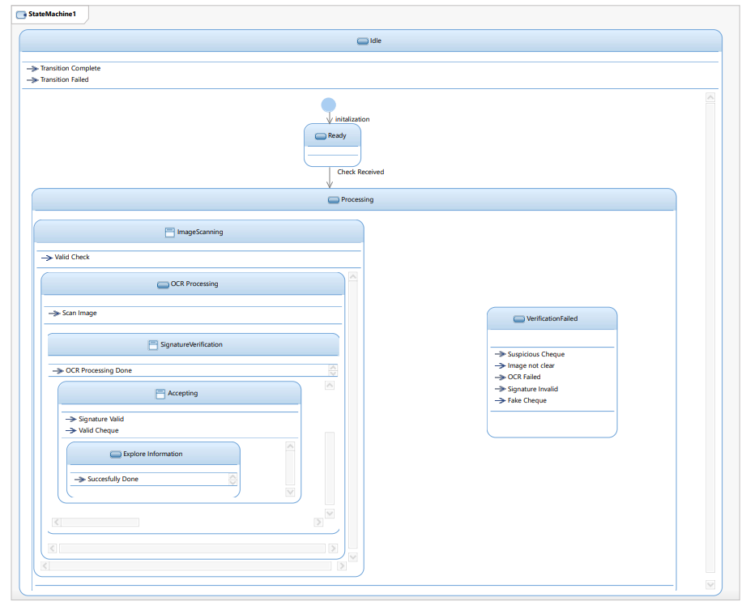
State Machine Diagram:
A state machine diagram in UML (Unified Modeling Language) is a behavioral diagram that represents the dynamic behavior of a system or a part of a system over time. It is particularly useful for modeling the behavior of objects or components that can exist in a finite number of states and transition between these states based on events.

Slide 17
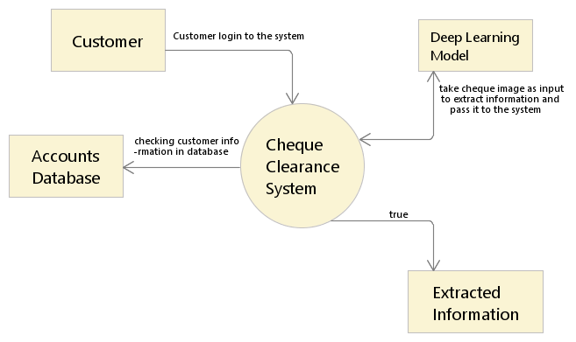
Data Flow Diagram: Data flow diagrams are also categorized by level. Starting with the most basic, level 0, DFDs get increasingly complex as the level increases. As you build your own data flow diagram, you will need to decide which level your diagram will be.
Level 0 DFDs, also known as context diagrams, are the most basic data flow diagrams . They provide a broad view that is easily digestible but offers little detail. Level 0 data flow diagrams show a single process node and its connections to external entities.

Slide 18
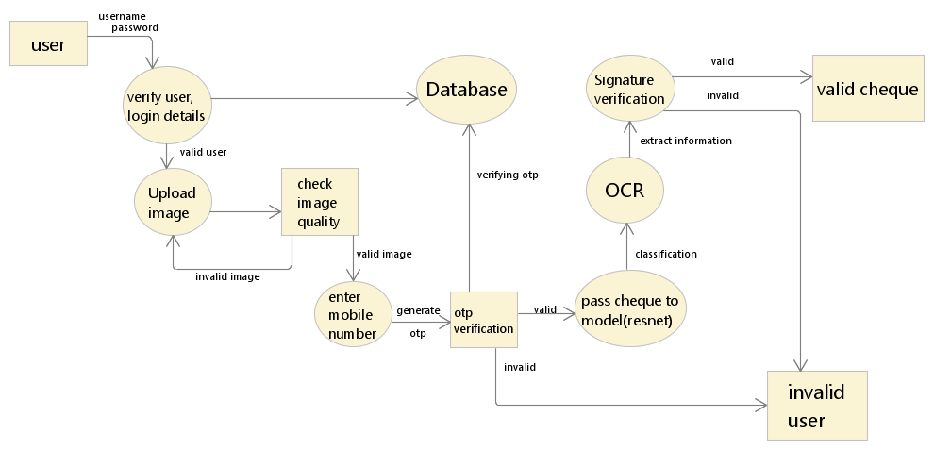
Level 1 DFDs are still a general overview, but they go into more detail than a context diagram. In level 1 DFD, the single process node from the context diagram is broken down into sub-processes. As these processes are added, the diagram will need additional data flows and data stores to link them together.

Slide 19
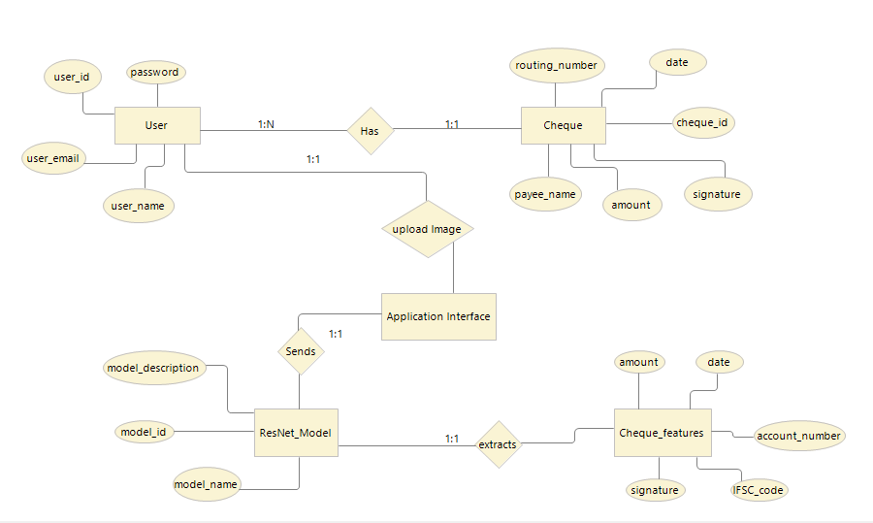
ER Diagram: An Entity Relationship (ER) Diagram is a type of flowchart that illustrates how “entities” such as people, objects or concepts relate to each other within a system.

Slide 20
Requirements
SOFTWARE REQUIREMENTS:​
​
Python Programming Language
Visual Studio Code (IDE)
TensorFlow​
Open CV
Git​
Cloud Services
Windows 10
HARDWARE REQUIREMENTS:
Desktop/Laptop
Processor- i5
Ram – 8GB
NVIDIA GeForce RTX GPU with CUDA
Memory – 1TB

Slide 21
ALGORITHMS USED
Optical Character Recognition (OCR): OCR used for the recognition of handwritten and printed text on cheques.
Residual Network (ResNet): ResNet is a Convolutional Neural Network architecture designed to support hundreds or thousands of convolutional layers. It uses the Skip Connection to train the system that solves the vanishing gradient to increase accuracy.
Structural Similarity Index Measuring: It is the technique used for signature verification.

Slide 22
OCR Technique:- Optical character recognition (OCR) algorithms allow computers to analyze printed or handwritten documents automatically and prepare text data into editable formats for computers of efficiently process them. It is another way to extract and leverage business critical data.
Resizing allows you to make your image smaller or larger without cutting anything out.
Image compression is a process applied to a graphics file to minimize its size in bytes without degrading image quality below an acceptable threshold.
Contours detection is a process can be explained simply as a curve joining all the continuous points (along with the boundary), having same color or intensity.
Edge detection is an image processing technique for finding the boundaries of objects within images.
Image masking is a technique used in photo editing to separate or isolate specific areas of an image from the rest, allowing for more precise editing and manipulation.

Slide 23
Grading is essentially altering the look of an image to enhance the appearance of the video image.
ResNet Algorithm:-
ResNet, short for Residual Network, is a type of deep neural network architecture that is highly popular in the field of computer vision, particularly for tasks like image classification and object detection.
It provide a novel way to add more convolutional layers to a CNN, without running into the vanishing gradient problem, using the concept of skip connections.
ResNet-50 uses a bottleneck design for the building block, which reduces the number of parameters and matrix multiplication.
This enables faster training of each layer.

Slide 24
Working Steps of ResNet-50 algorithm :-
Input Image: The process begins with an input image of a cheque that needs to be verified for authenticity.
Image Preprocessing: The input image undergoes preprocessing steps, such as resizing and normalization, to ensure it is in a suitable format for processing.
ResNet algorithm : ResNet-50 uses residual blocks, which are composed of several convolutional layers. These blocks help the model learn complex patterns in the image by focusing on the residual (difference) between the input and output of the block.
Feature Extraction: The processed image passes through multiple layers of the ResNet-50 model, where features relevant to cheque authentication are extracted. These features might include patterns, textures, and other relevant information.
Classification: The extracted features are then fed into a classification layer, which determines whether the cheque is real or fake. This layer is typically a fully connected neural network that outputs a probability score for each class (real or fake).
Deployment: Once the model has been trained and tested successfully, it can be deployed in a system, where it can be used to automatically verify the authenticity of cheques.
Overall, the ResNet-50 algorithm plays a crucial role in the Online Cheque Curation And Abstract system by enabling the automated analysis and verification of cheque images, helping to prevent fraud.

Slide 25
Structural similarity index measure :-
The structural similarity index measure (SSIM) is a method for predicting the perceived quality of digital television and cinematic pictures, as well as other kinds of digital images and videos. It is also used for measuring the similarity between two images.
In order to evaluate the image quality, this formula is usually applied only on luma, although it may also be applied on color (e.g., RGB) values or chromatic (e.g. YCbCr) values. The resultant SSIM index is a decimal value between 0 and 1, where 1 indicates perfect similarity, 0 indicates no similarity. For an image, it is typically calculated using a sliding Gaussian window of size 11x11 or a block window of size 8×8. The window can be displaced pixel-by-pixel on the image to create an SSIM quality map of the image.

Slide 26
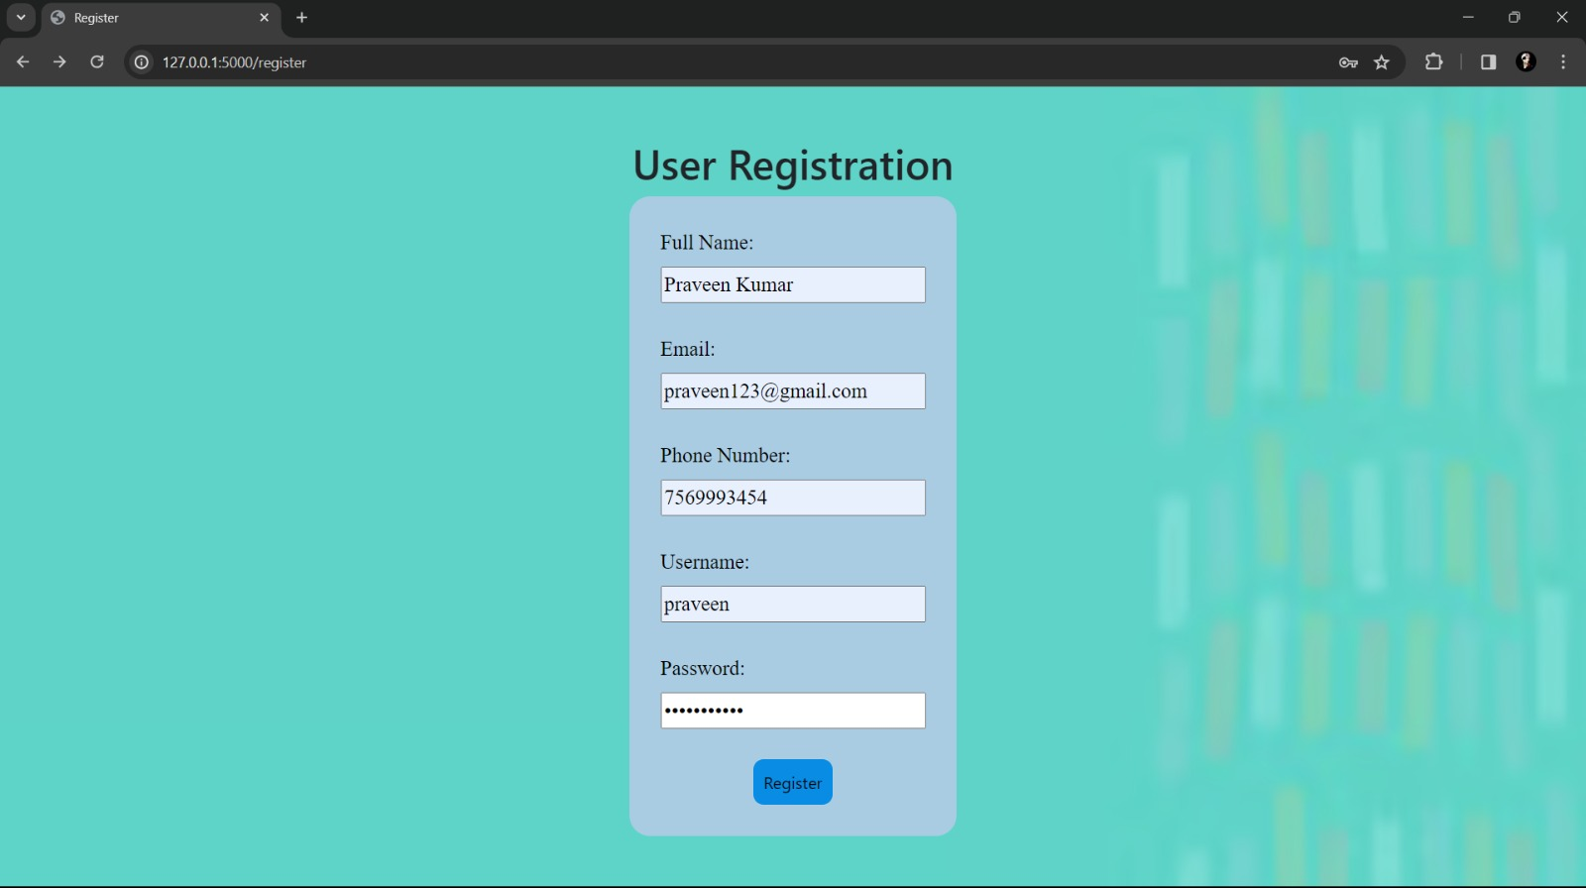
Screen Design:

Slide 27
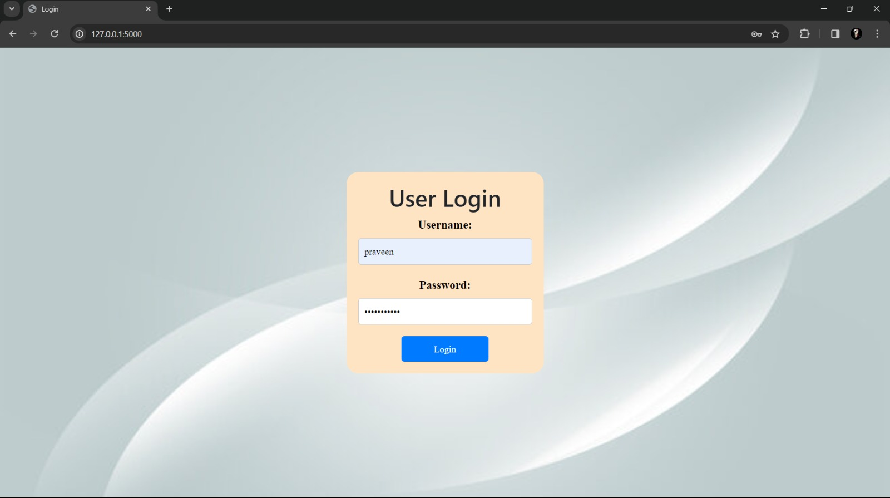

Slide 28
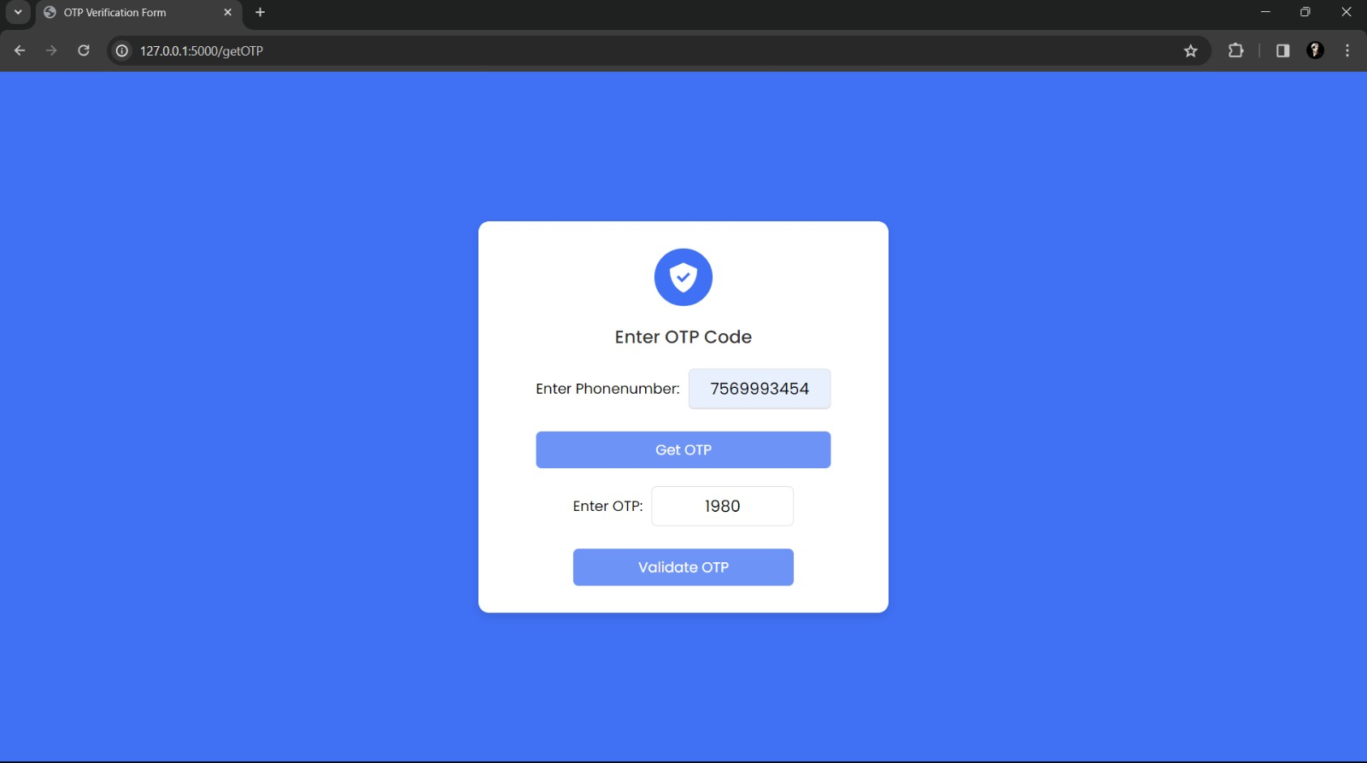

Slide 29
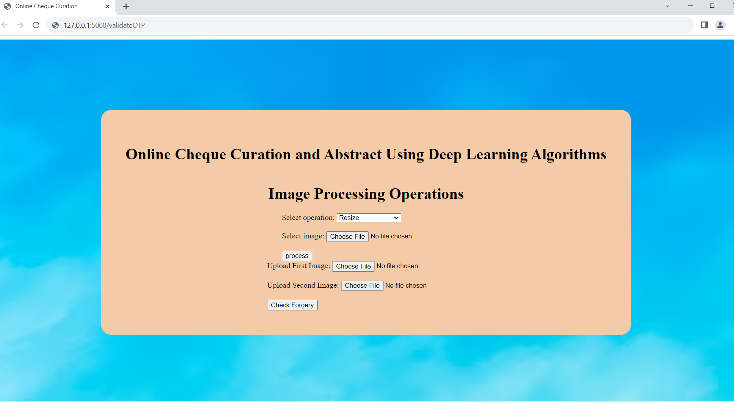

Slide 30
Test Cases
Test ID | Test description | Test case | Expected result | Actual result | Status
TC_001 | Verifying the functionality of registration page | Enter valid details( E.g. name, phone number, email Id, password) | User registered successfully | Redirected to login page | Pass
TC_002 | Verify the functionality of login page | Enter valid Username and password | User login successfully | Redirected to OTP Verification page | Pass
TC_003 | Verify the functionality of login page | Enter invalid Username and password | Incorrect Username or password | Invalid Username or password | Pass
TC_004 | Verify the functionality of OTP Verification page | Enter Valid Phone number and Generated OPT | OPT Successfully validated | Redirected to page Online cheque curation page | Pass

Slide 31
TC_005 | Verify the functionality of Online cheque curation page | Upload dataset, split dataset, Cheque image | Image processed successfully | The system accurately performs the image processing operations | Pass
TC_006 | Verify the functionality of Online cheque curation page | Upload the first image, second image | Signature verification done successfully | The cheque is fake or not based on signature verification | Pass
TC_007 | Verify the functionality of Online cheque curation page | Upload the image other than cheque | The system unable to processes | ValueError: Input images must have the same dimensions. | Pass

Slide 32
REFERENCES
[1] S. Baker, “Don’t cash that check: BBB study shows how fake check scams bait consumers,” Tech. Rep., Better Bus. Bureau, Arlington County, VA, USA, Sep. 2018.
[2] L. M. Rose, “Modernizing check fraud detection with machine learning,” Ph.D. dissertation, Dept. Financial Crime Compliance Manage., Utica College, Utica, NY, USA, 2018.
[3] Federal Trade Commission, “Consumer sentinel network data book 2017,” Federal Trade Commission, Washington, DC, USA, Tech. Rep.,Mar. 2018.
[4] C. Tressler, “FTC: The bottom-line on fake checks scams,” Federal Trade Commission, Washington, DC, USA, Tech. Rep., Feb. 2020.

Slide 33


